Slide 1



"Cars24 Data Analytics Project"
By Geetanjali

Slide 2
Project Overview
Data Collection: Scraped car pricing data from the Cars24 website for two major cities.
Data Cleaning: Handled missing values, removed duplicates, and standardized data types.
SQL Analysis: Extracted key insights such as the least and most expensive cars for each brand and compared average price
Dynamic Dashboard: Created an interactive Excel dashboard with slicers for easy data exploration.
Key Trends: Identified patterns and trends in car prices across different brands and models.
Future Work: Suggested further analysis and potential improvements for deeper insights.

Slide 3
Dataset Overview
Quick Overview of the Dataset:
Key Columns:
Car Model . Registration ID
Brand . Monthly EMI
Car Name . Car Price
Car Variant . Downpayment
Car Transmission Amount
KM Driven . Location
Owner Type
Fuel Type
The dataset comprises car listings scraped from the Cars24 website for two metro locations.
Contains data on various car attributes and pricing details.
Includes a total of 500+ rows, ensuring a comprehensive analysis.

Slide 4
Significance
Make better decisions: Whether you're buying, selling, or designing cars, data can help you make smarter choices.
Save money: Understanding car prices and trends can help people save money.
Identify trends: Understand how car prices, models, and customer preferences are changing.
Contribute to academic research: Your findings can be used for further research on the used car market.
Protect the environment: Data can help us understand which cars are more environmentally friendly.

Slide 5
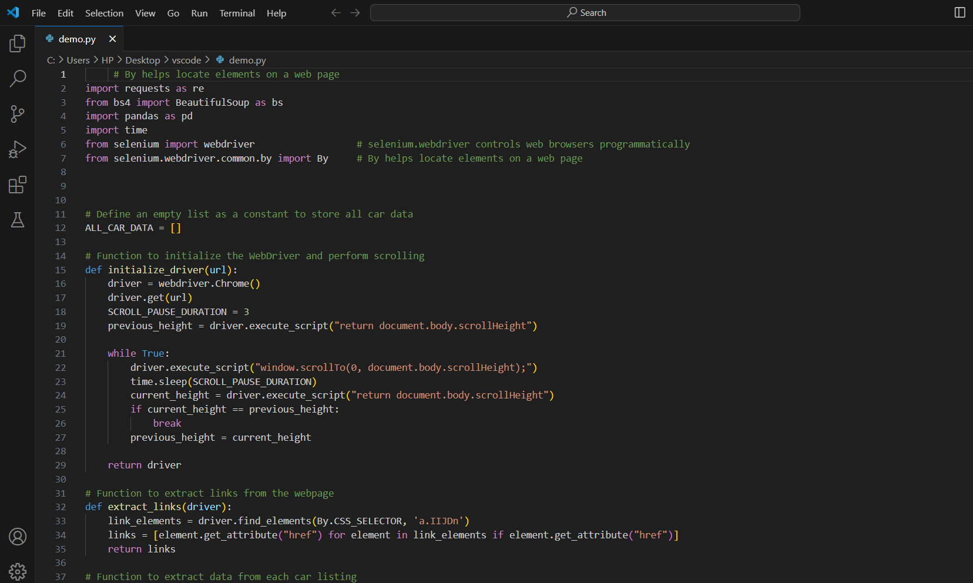
Methodology
Python was used to scrape and clean the data. SQL helped identify price extremes and compare averages. Excel provided an interactive dashboard for visualizing trends.
Python/ Web scrapping
Used Python with libraries such as BeautifulSoup and Selenium to scrape data from the Cars24 website.
Collected data for two metro locations, ensuring a minimum of 500 rows per location

Slide 6
Data Cleaning
Data cleaning is the process of identifying and correcting errors, inconsistencies, and incomplete data in a dataset. It's like tidying up your data before using it.
Why is it important?
Accuracy: Ensures data is correct and reliable.
Efficiency: Saves time and effort in analysis.
Better Insights: Accurate data leads to better understanding and decision-making.
Common data cleaning tasks include:
Removing duplicates
Handling missing values
Standardizing formats

Slide 7
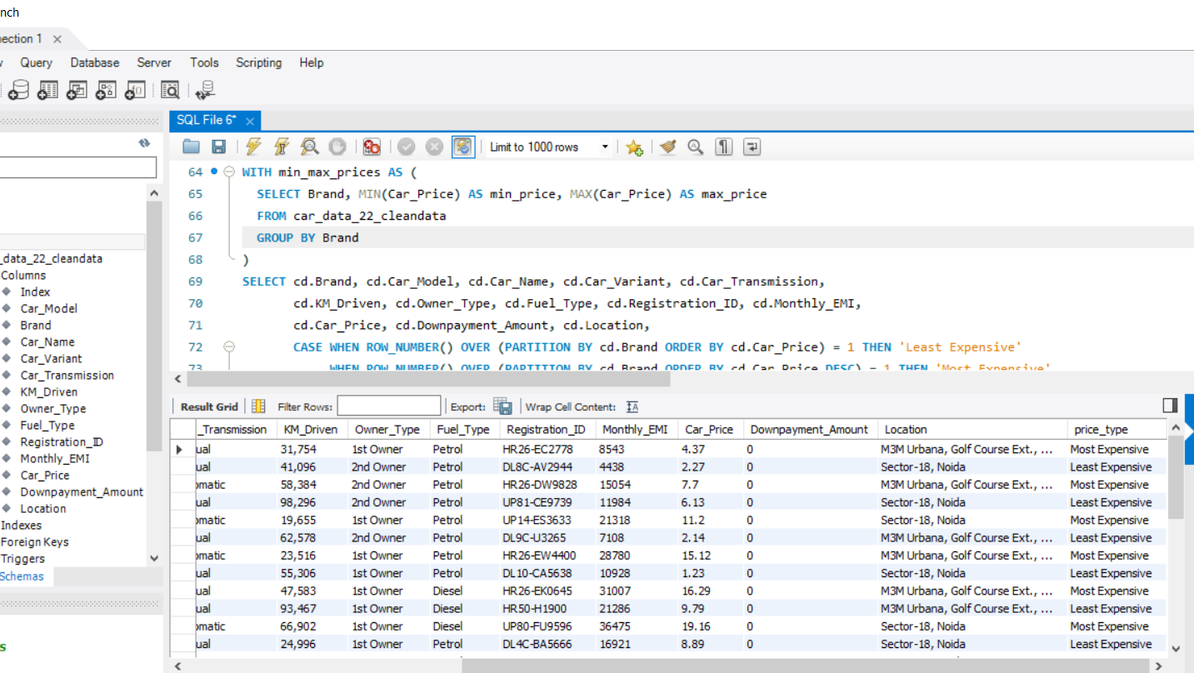
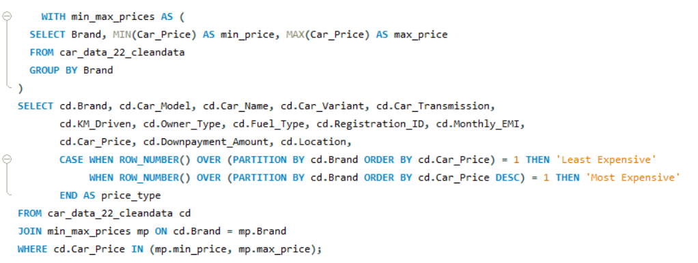
SQL
Ques1:
Identify the least expensive and most expensive cars for each brand with specifications.

Slide 8
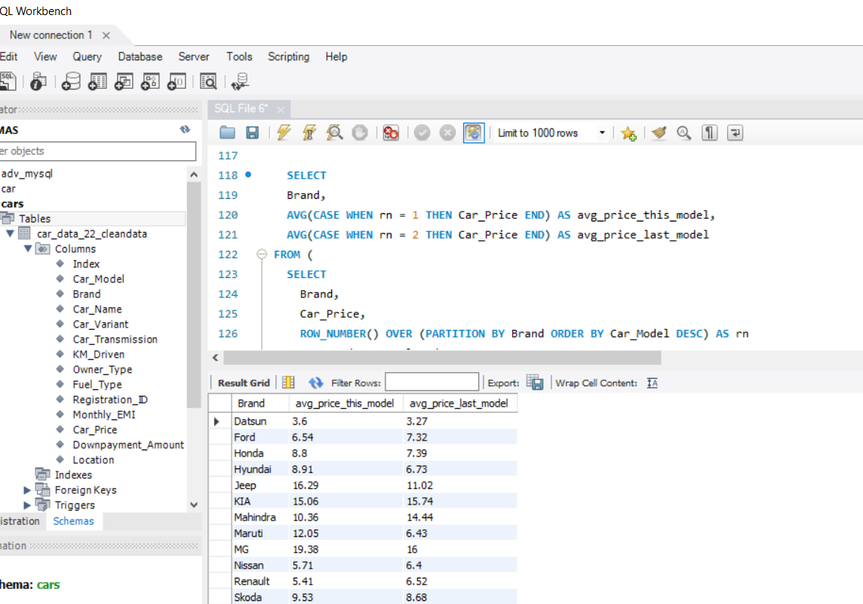
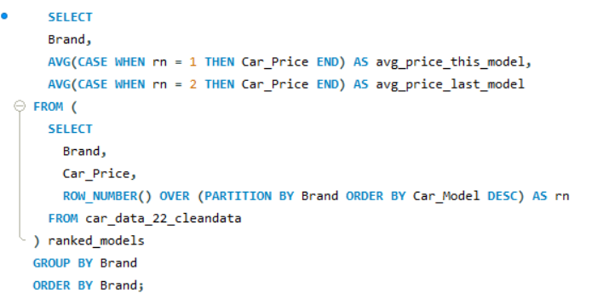
Ques2
SQL query calculates the average price of the latest and second-latest car models for each brand

Slide 9
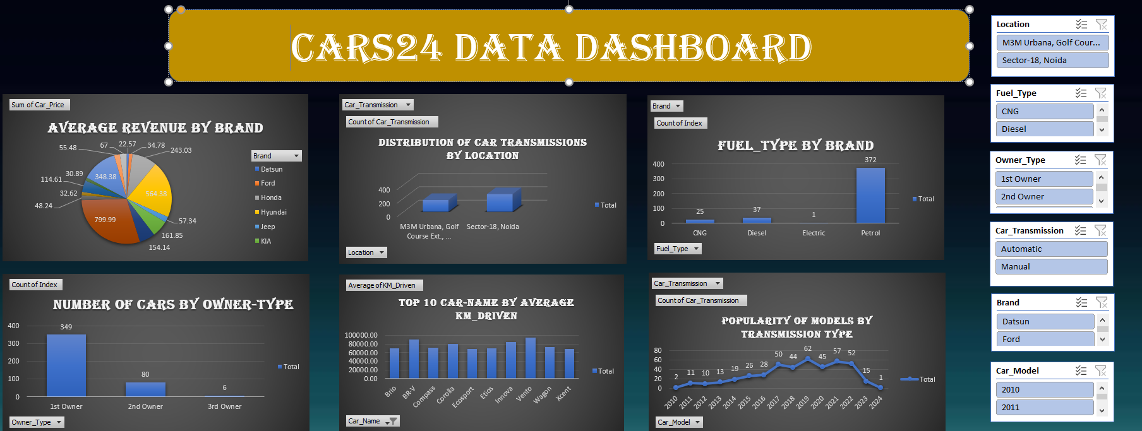
Excel:
Developed an interactive dashboard for data visualization.
Questions:
What is the Average revenue of cars by Brand?
What is the distribution of car transmission by location?
What is the distribution of fuel_type by Brand?
How many cars have been listed by each owner type?
Top-10 Car-Name by average KM_Driven?
How does the popularity of different car models vary by transmission type?

Slide 10
Conclusion
Main Finding
Challenges and Considerations
Ford has the highest average revenue among brands.
Petrol is the most popular fuel type.
Most cars are first-owned.
Vento has the highest average KM_Driven among Cars.
Website Structure Changes: Frequent updates to website layouts can break your scraping scripts.
Data Consistency: Extracted data might be inconsistent due to varying formats or missing values.
Choose the Right Tools: Utilize libraries like BeautifulSoup, Scrapy, or Selenium based on project requirements.
Data quality issues (e.g., missing values, inconsistencies)

Slide 11
Thank You
Thank you for your attention.
Email: anjalidagar880@gmail.com
Linkedin:
https://www.linkedin.com/in/geetanjalidagaranalyst/

